Slide 1
Startup basics - Mind to Market
A peek of start-ups and the ecosystem in Y-combinator,500 startups, etc.

Slide 2
Some Rules
Be crisp in what you tell
Be honest with yourself
What I share is not a universal truth
Each person is different and may have specific capabilities
Don’t write anything

Slide 3
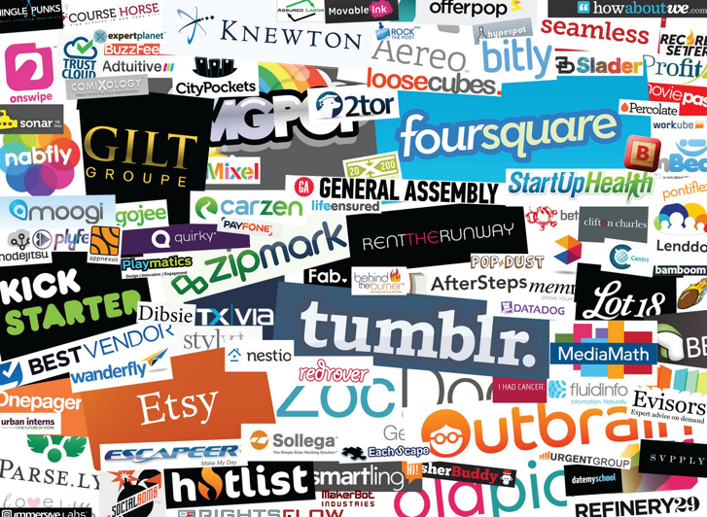

Slide 4
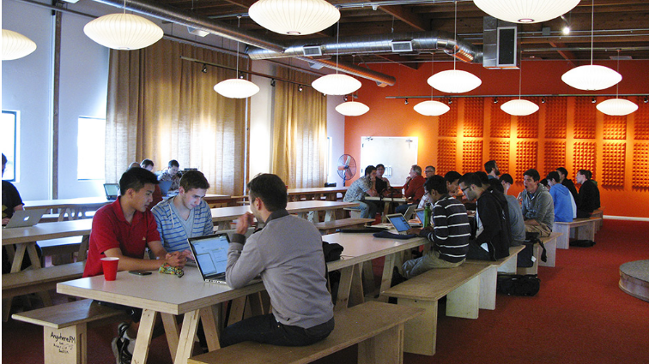
YC office

Slide 5
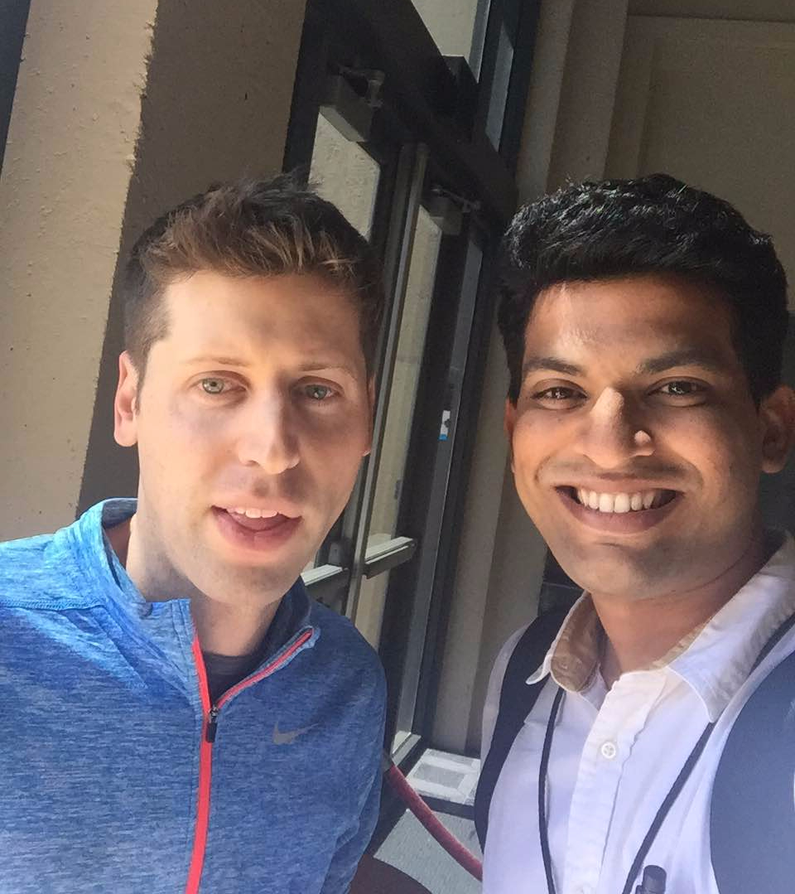
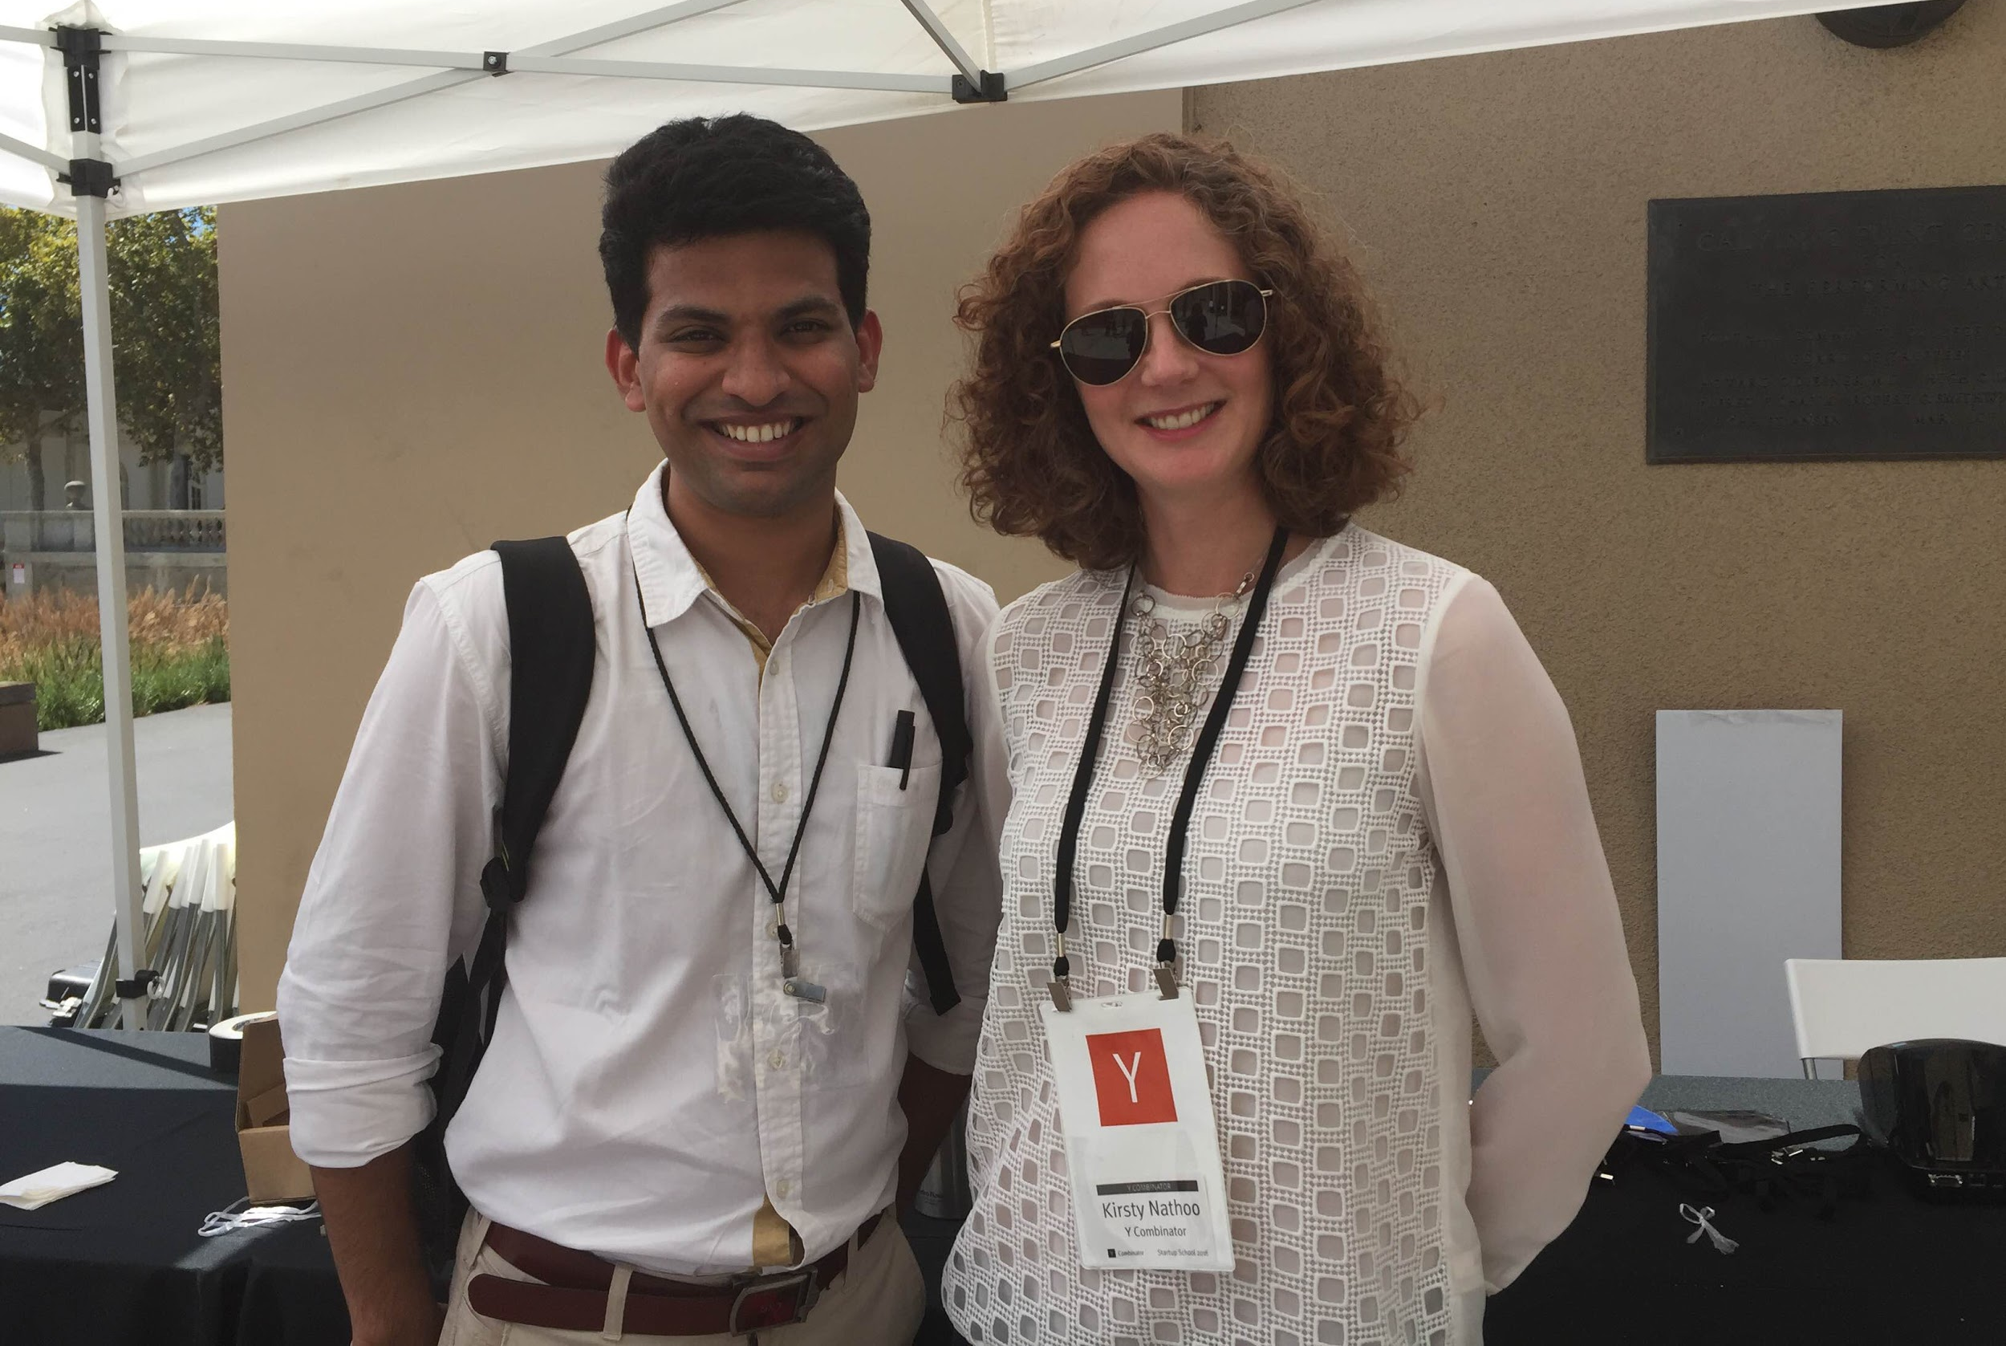

17th September, 2016
Sam Altman
Kirsty Nathoo
YC startups made a fantastic presentation, followed by office hours. Gobble.com’s presentation was inspiring. Hetal and Gaurang, met several entrepreneurs at the event. Around 600 bright people witnessed the YC event live at the Flint center.

Slide 6
Definitions
Equity
ownership in the company in % or shares
Venture Capitalist
Invests other people’s money and takes a fee + % of winnings
Angel Investor
Rich person who can invest (>$1M)
Super Angel
Really rich person who invests a lot (>$50M)
Seed Round
First round of official financing
Series A/B/C
subsequent “big” rounds of financing
IPO
Going public on the stock market
Incubator/Accelerator
program to help your early-stage company

Slide 7
Definitions
Common Stock
founder stock (what employees and founders get)
Preferred Stock
investor stock (what VCs/Angels get)
gives them the right to their money back before founders
Vesting
gradual grant of funding/equity over time rather than all-at-once
designed to get you to commit long-term
Convertible Debt
investment financing technique that gets you money now with a promise for the % equity calculation when a formal big round is raised (at that same rate)

Slide 8
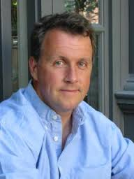
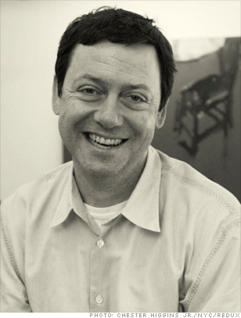
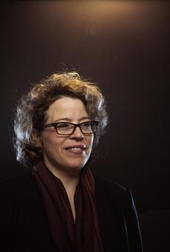
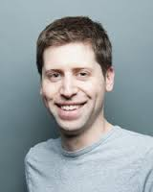
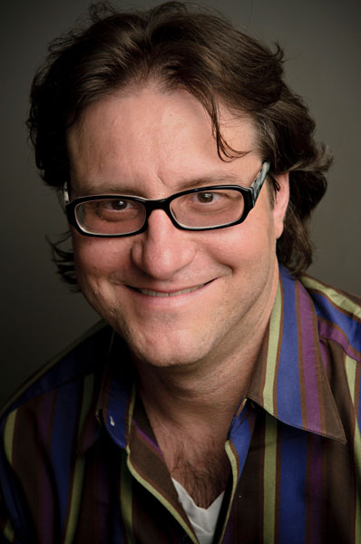
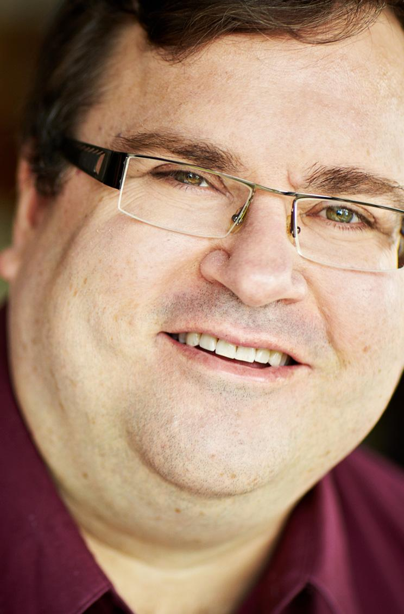
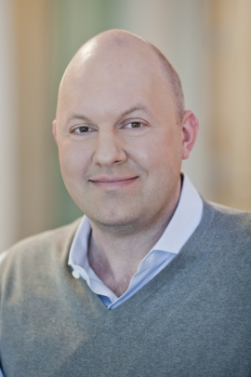
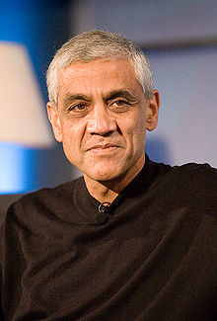
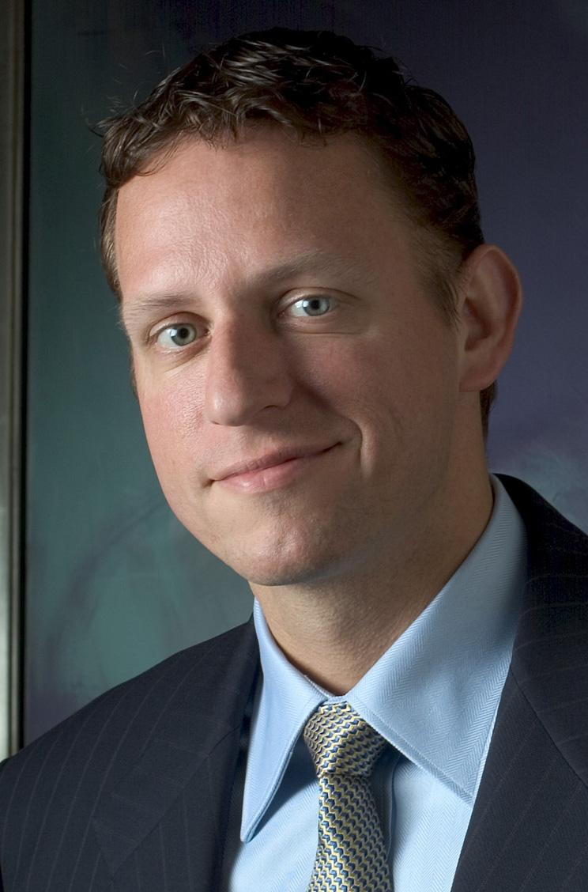
People You Need to Know - Investors/Mentors
Paul Graham
YCombinator
Father of Startups
Essays
Fred Wilson
Union Square VC
Flatiron Partners
Katie Rae
TechStars
Project 11
Boston Ecosystem
Sam Altman
YCombinator
Loopt
Power fundraiser
Brad Feld
TechStars
MIT
FeldThoughts
Reid Hoffman
LinkedIn
Facebook
Silicon Valley
Marc Andreessen
Netscape
A16Z
FB, Ebay, HP
Vinod Khosla
Khosla Ventures
Sun/JAVA/NFS
Peter Thiel
Paypal
Palantir
Facebook

Slide 9
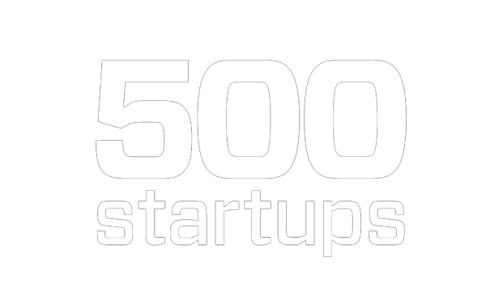

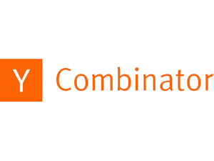










Organizations you must follow:

Slide 10
Why NOT start a startup?
High risk and probability of failure
Frequent ups and downs
Low on cash
Family pressure
Rejection from many investors/incubators/skeptics
Very long hours
Crazy social life
Average exit time ranges from 6-8 years!
Just to do a startup
No interest in the field/space, just want to do a business
Can’t jump in full-time unless you have $X or win Y or have a “Z Co-founder”

Slide 11
Why start a startup?
Following your passion
You are the leader
Flexibility
Fame/fortune/impact
Learn life’s lessons in a much shorter period of time
Branding yourself
Age (no age barrier to startup, but theres an edge to young innovators)

Slide 12
Keep it simple!
Explain UBER in one sentence?

Slide 13
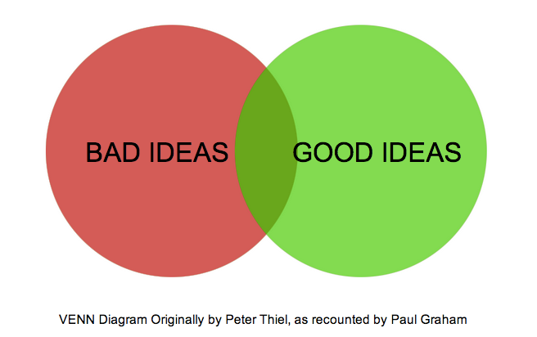
Good / Bad Idea
“Make something people want!”
“Solve a real problem!”
“Find the customer first!”
“Move fast and validate!”
“What’s your unfair advantage?”
“What do you understand that others don’t?”
“What’s new and what do people resort to because it doesn’t exist?”

Slide 14
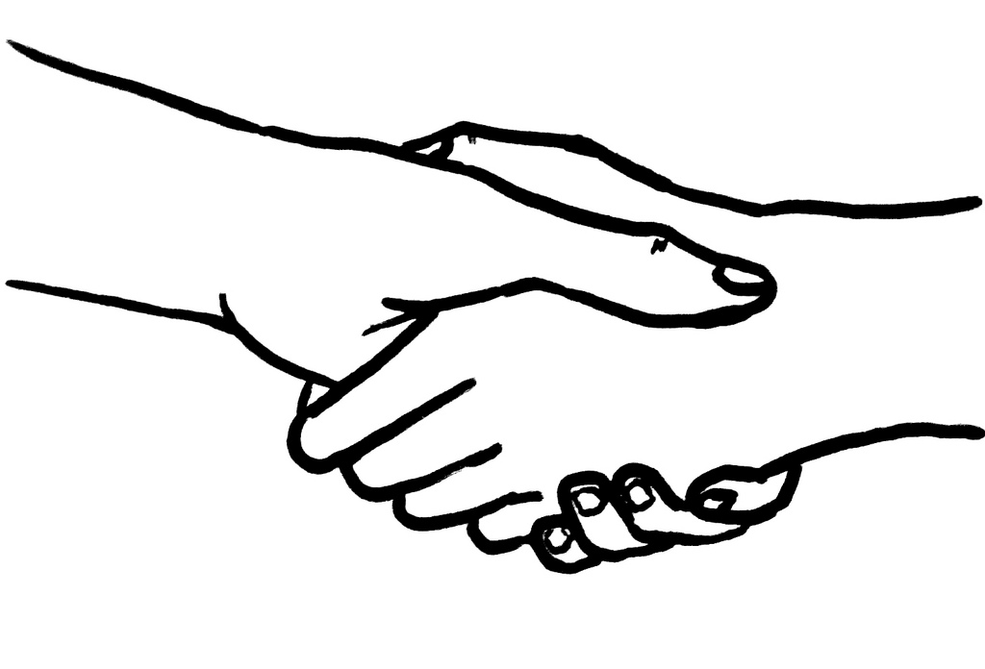
Building a Founding Team
2-3 Founders; Ideally 2
CEO & CTO (no COO or CMO)
Someone you know well & work well
Done things outside expertise and “hack the system”
Rarely family or close friends
Roommate bad signaling
Someone you an be honest with and fight

Slide 15
Full-time is a must
Part-time
A bad signal for everyone involved
Hard to be flexible
Moves slower
Full-time
usually self-financed
flexible with opportunities and travel
powerful signaling for yourself

Slide 16
Incubators & Accelerators
Standard
5-7% Common Stock for $15-18K + Conv. Note
3-12 months of incubation time
meetings with mentors, investors, community events, entrepreneurs, techies
Demo Day event (good and bad)
Free legal or finance help
New Standard? 5-7% Common Stock for $120K

Slide 17
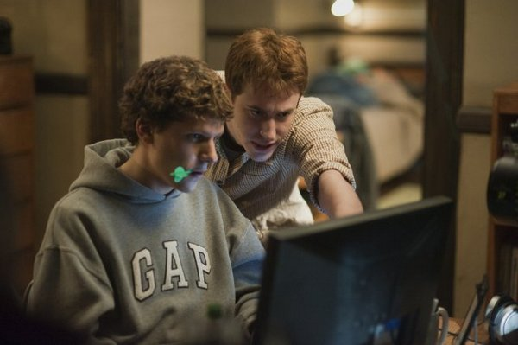
Equity
Document each discussion
Bad idea: 50/50 split
Founders (first 3 people)
5-50%
Early Employees (first 2 or 3 hires)
1-2% (different for non-tech)
Regular Employees (beyond first 5 or 10 hires)
<1%

Slide 18
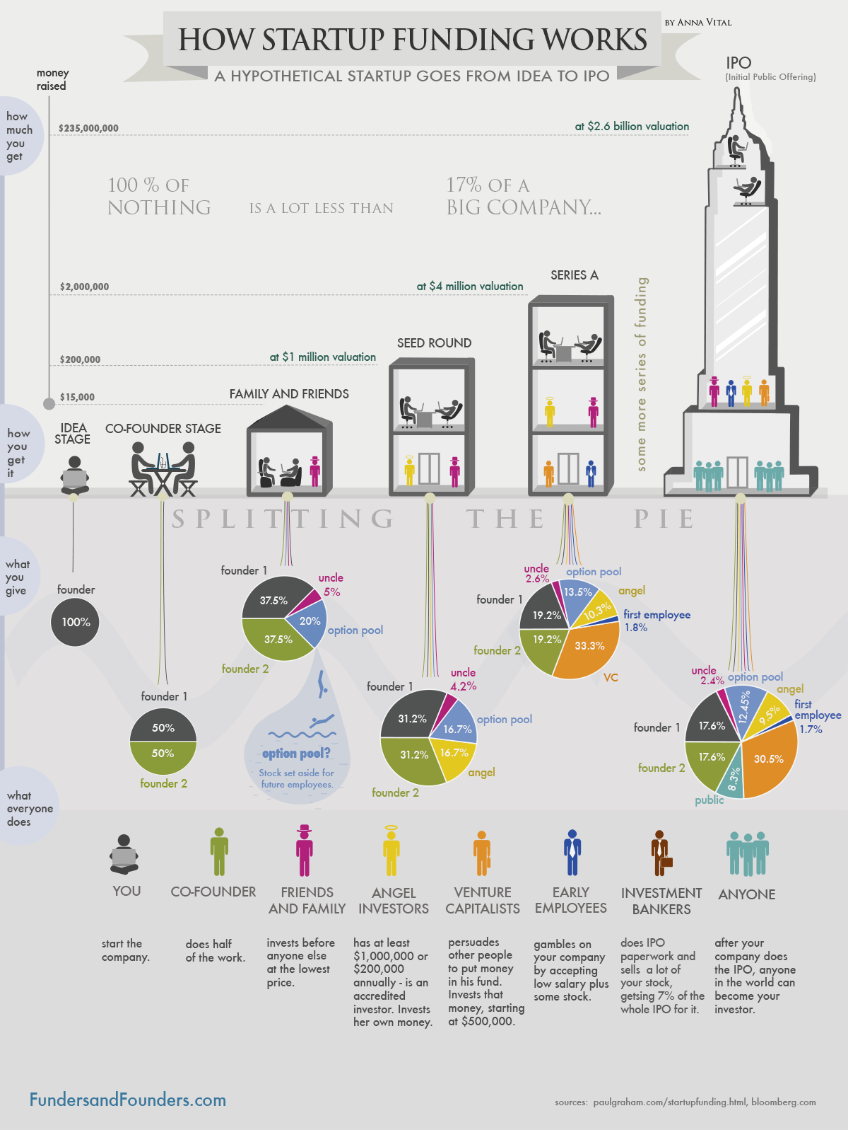

Slide 19
When?

Slide 20
Questions to ask
Is this a highly scalable idea?
Only a prototype does not suffice, do you have a manufacturable product?
How many people need your product right now?
Do you have a paying customer NOW?
Is this the right team & right time personally?
Is it the right time for the product?
Who are the players in the market who are interested in the same domain and what are they doing?
Is this something you could see yourself doing for 10 years?
Are you doing enough hustle?
Does the founding team have a good track record?

Slide 21




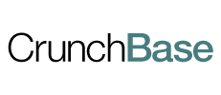

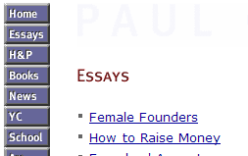


Websites You Need to Know
Hacker News
r/Startups r/Entrepreneurship
Paul Graham’s Essays

Slide 22
Don’t Settle.

Slide 23
From Idea to Market
Idea
Incubate
Invest
Impact
Innovate
Chess Automated
A physical board on which users can enjoy chess -
1.vs Machine
2.Visually Impaired.
3.Distant opponent.
4.Training kits
Got incubated at RiiDL & they were supported with -
1.Space and facilities to develop their first prototype.
2. Connected them to various individual mentors and investors.
Raised INR 77 Lacs from Individual Investors.
Creating employment
Working with National Association of Blind, Chess Schools, etc

Slide 24
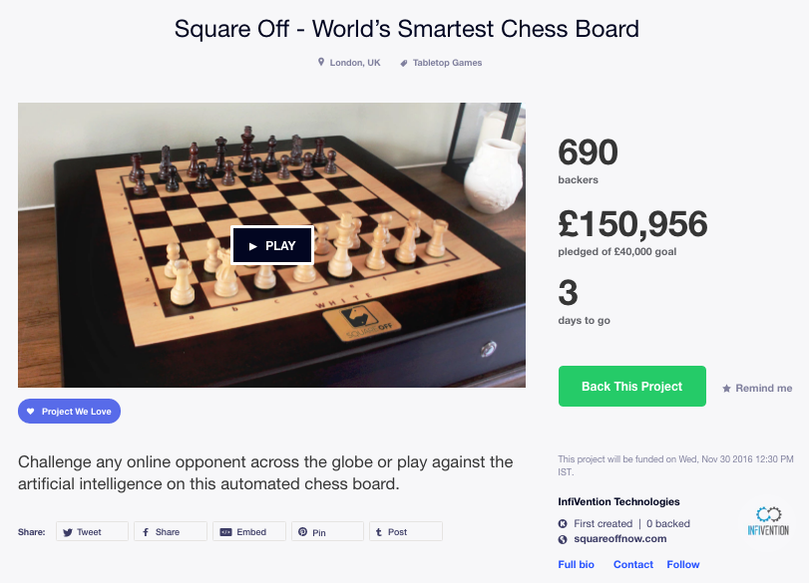

Slide 25


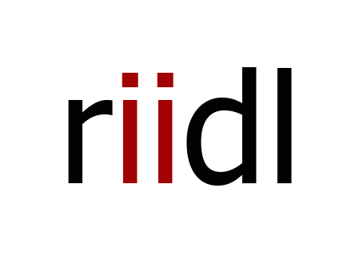

https://www.facebook.com/riidl
https://www.facebook.com/makermelaIndia/
#makermelaindia

